Slide 1
Optics Laboratory
2nd Grade - 1st Semester
2018/2019
Instructors
Assist. Prof. Dr. Sabah Ibrahim
Assist. Lect. Muhanned Jamal
Assist. Lect. Najwa Ibrahim

Slide 2
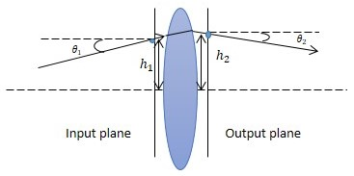
Experiment Ten Determination of focal lens by using matrix method
Apparatus:
Optical bench, Convex Lens (+200 mm), Screen Paper grid pattern.
Theory:
Ray transfer matrix analysis (also known as ABCD matrix analysis) is a type of ray tracing technique used in the design of some optical systems, particularly lasers. It involves the construction of a ray transfer matrix which describes the optical system; tracing of a light path through the system can then be performed by multiplying this matrix with a vector representing the light ray.

